Slide 1
Introduction to Computer Programming Lecture 8.3:
Curve Fitting
Hemma Philamore
Department of Engineering Mathematics

Slide 2
Introduction to Computer Programming Lecture 8.3.a:
Fitting a Function to Data
Hemma Philamore
Department of Engineering Mathematics

Slide 3
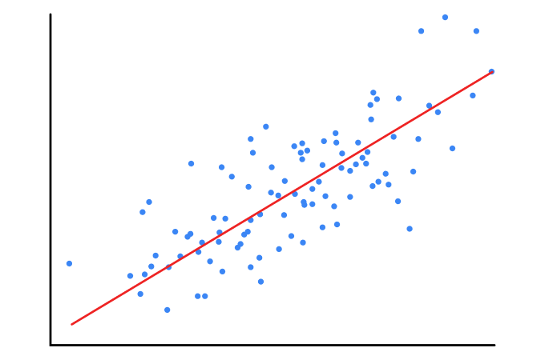
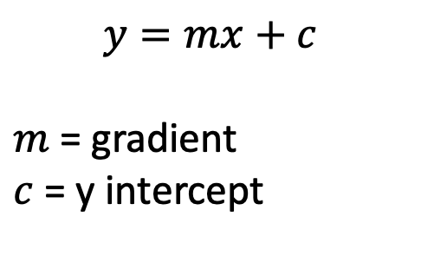


Linear Regression
$$y=mx+c$$
$m$ = gradient
$c$ = y intercept
$$y$$
$$x$$

Slide 4
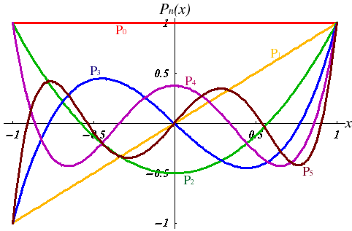
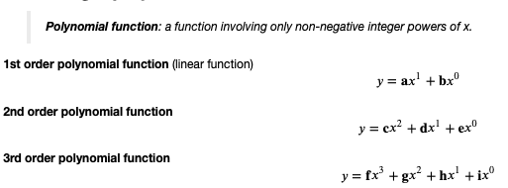
Fitting a Polynomial Function
Polynomial function: Only non-negative powers of $x$

Slide 5

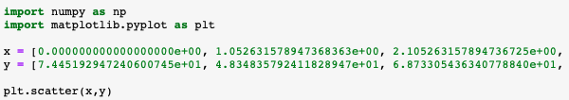
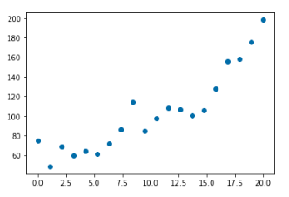
Fitting a Polynomial Function
Import required modules
Two lists (not all elements shown on this slide)
Scatter plot

Slide 6
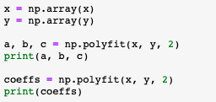
Fitting a Polynomial Function
Convert list to array for numpy operations
3 coefficients, 3 variables
3 coefficients, 1 data structure, 3 elements

Slide 7
polyfit: coefficients of polynomial
Convert list to array for numpy operations
3 coefficients, 3 variables
3 coefficients, 1 data structure, 3 elements

Slide 8
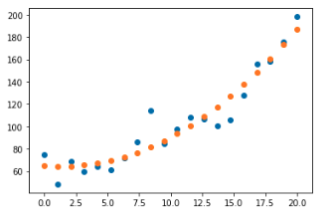
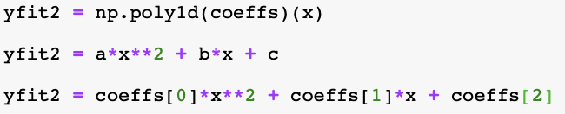

poly1d: generate fitted data
More efficient than typing polynomial equation
Array to fit values to

Slide 9
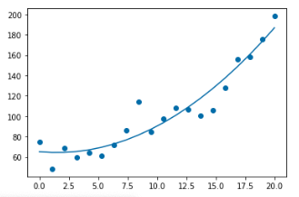
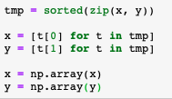

Monotonic x data
Sorts monotonically based on first variable
Split list of tuples using list comprehension

Slide 10
Introduction to Computer Programming Lecture 8.3.b:
Fitting a Function to Imported Data
Hemma Philamore
Department of Engineering Mathematics

Slide 11
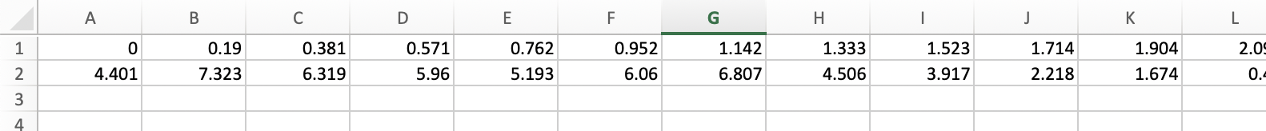
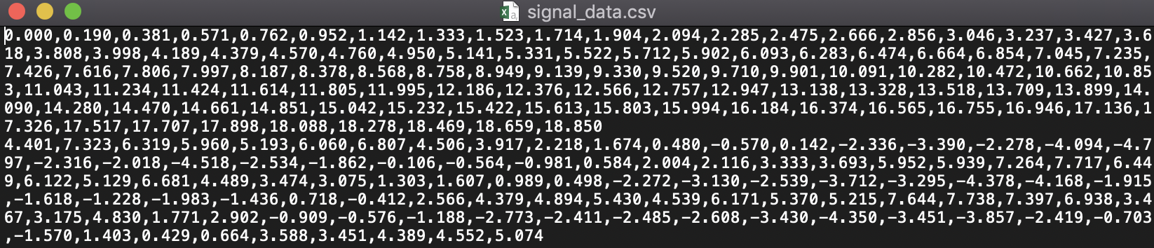
Importing data

Slide 12
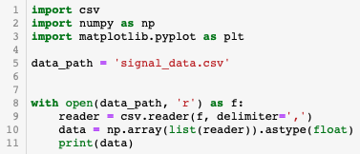
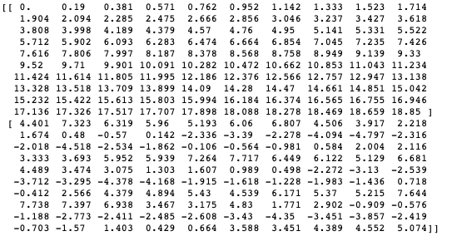
Importing data
File in current directory
Open as read only
Specify delimiter
Convert imported data to numpy array
2 rows,
100 columns

Slide 13
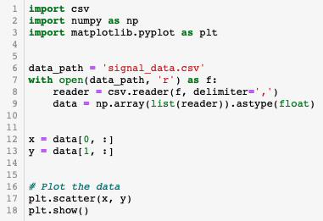
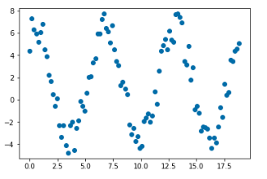
Importing data
Open as read only
Select the data of interest

Slide 14


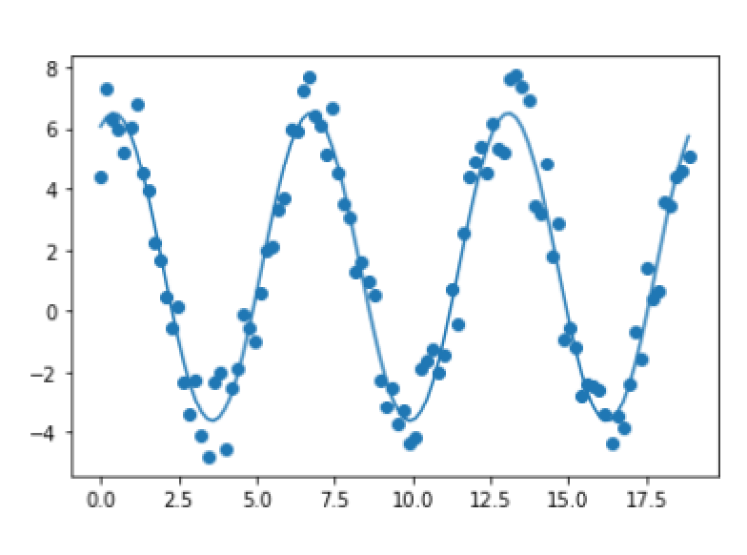

curve_fit: fit an arbitrary function
Define function with unknown constants
Function from scipy package
Two returned variables
* ‘unpacks’ the variable (to give 4 variabales in this case)

Slide 15
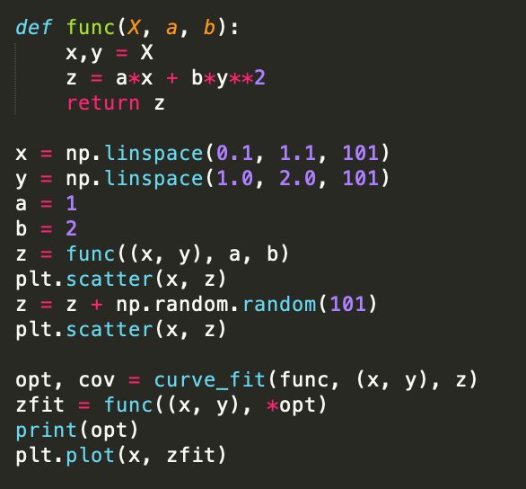
curve_fit: multiple variables
X is a data structure with two elements x, y
Generate some randomized data
Fit a curve using
Independent variables (x, y)
Dependent variable z

